Slide 1


Ok, what’s up?
In the box?
Out the box?
New box?
No box?
Yes, yes, yes, and yes!
Why do I have to choose?

Slide 2
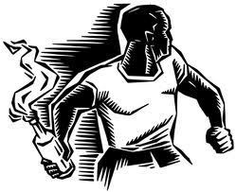
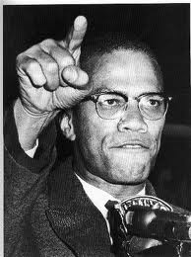
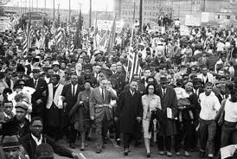
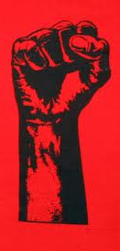
Why rethink the Black Liberation Movement?
The crisis is pushing hard
A new upsurge is coming
A new unity is possible
New theory is needed
We can learn from experience

Slide 3
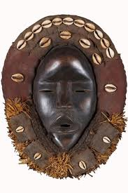
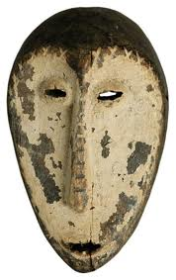
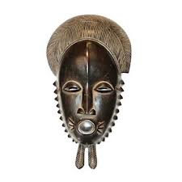
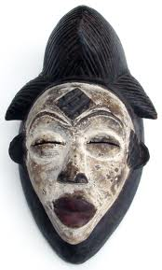
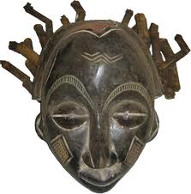
Basic argument
Black people face the boxes of class exploitation, national oppression, and racism
Black people have always had multiple movements fighting for freedom.
It is possible to understand a dialectic of unity and polarity within the movement
The movement strategy we need depends on the maximum unity possible
The fundamental crisis we face forces spontaneous convergence to build upon
We need a general methodological framework so we can all get on the same page
We need immediate action plans, and strategic plans as well

Slide 4
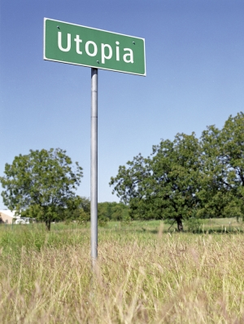
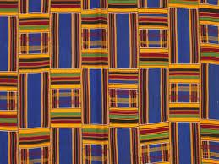
The no box option is a utopian vision
and not an immediate practical project.
But, it can help focus a philosophical and
moral position that can guide one into a
movement social change:
If you don’t know where
you are going, any road
will take you there.

Slide 5
Toward a revolutionary transformation
of everyday community life for all of us
De-Link from the boxes of the system of oppression | Re-Link to tradition and historic forms of survival – boxes we can live by
TV | Face to face culture – practicing the social arts of conversation and compromise, logic and humor
Fast food and soft drinks | Natural food and water –basically cut back on the red meat and place emphasis on fruits and vegetables
Dope | Connect both sides of your brain with positive cultural practices, and moral values
Quick fix mentality | Rebuilding trans-generational institutions for church, family, neighborhood, and fun
As usual, the question is how?

Slide 6
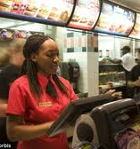

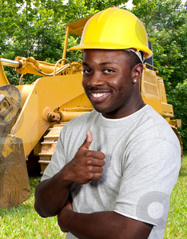
The objective situation
Class exploitation: exploitation of workers and the expelled
National oppression: racism and soft genocide
Gender oppression: male supremacy and homophobia

Slide 7


Technological revolution: a new moment:
Fundamental re-oganization
of the labor process
New class of 21st century
proletarians (Roman style)
National oppression becomes
soft genocide

Slide 8
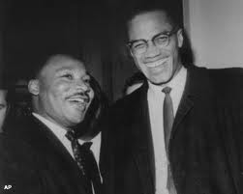
Our movements can be reborn and reunited
This moment gives us insight into our potential unity.

Slide 9
In the box
Civil rights
movement

Slide 10
In the box,
out the box
Civil rights
movement
Black
Caucuses
Pan Africanists-Nationalists

Slide 11
In the box,
out the box, and new box
Civil rights
movement
Revolutionary Democrats
Black
Caucuses
Marxists
Revolutionary
Nationalists
Pan Africanists-Nationalists

Slide 12
In the box,
out the box,
and new box:
the Black Liberation
Movement
Civil rights
movement
Revolutionary Democrats
Black
Caucuses
Marxists
Revolutionary
Nationalists
Pan Africanists-Nationalists

Slide 13
The Black Liberation
Movement
in
moments
of higher
unity
Civil rights
movement
Revolutionary Democrats
Black
Caucuses
Marxists
Revolutionary
Nationalists
Pan Africanists-Nationalists

Slide 14
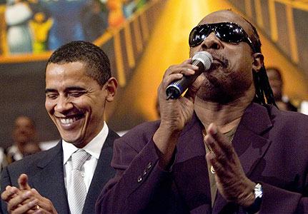
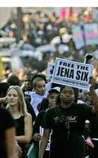
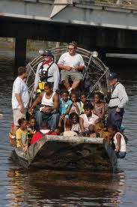
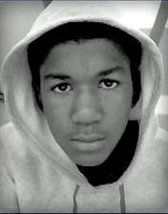
Critical moments of unity and upsurge for the BLM:
Jena Louisiana
Katrina
Trayvon Martin
Stevie Wonder singing for the IDF
Re-election of Obama (be careful what you wish for

Slide 15

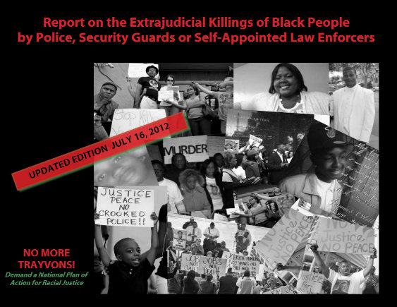
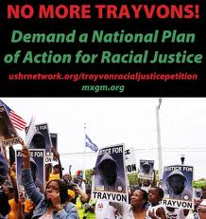
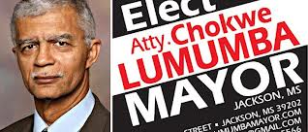
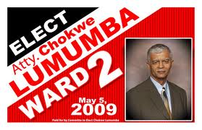

Slide 16
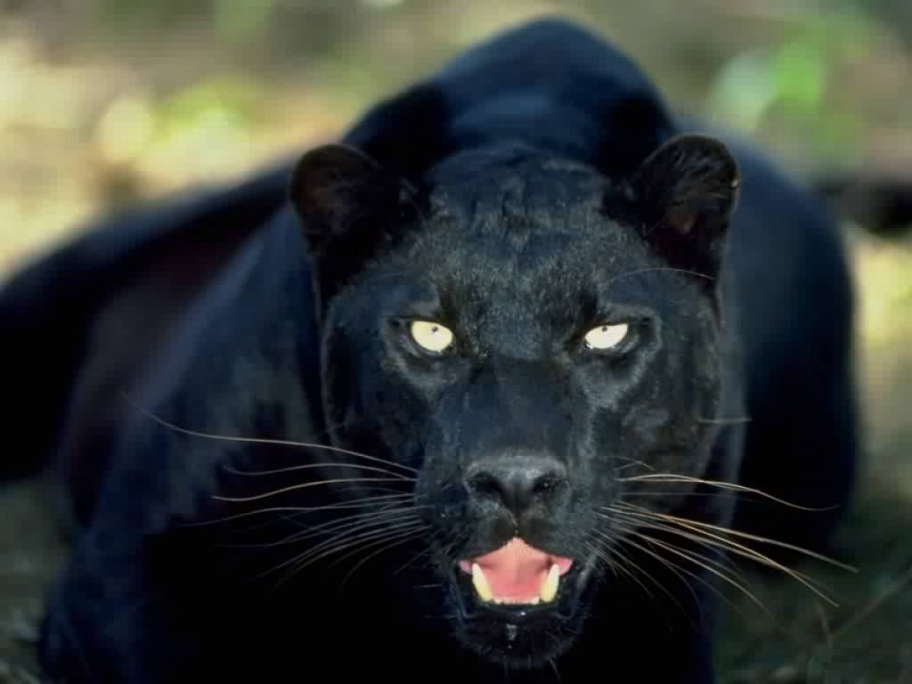

We may not have it all together,
but together we can have it all.
Freedom Now!

